Slide 1

Primary Memory

Slide 2
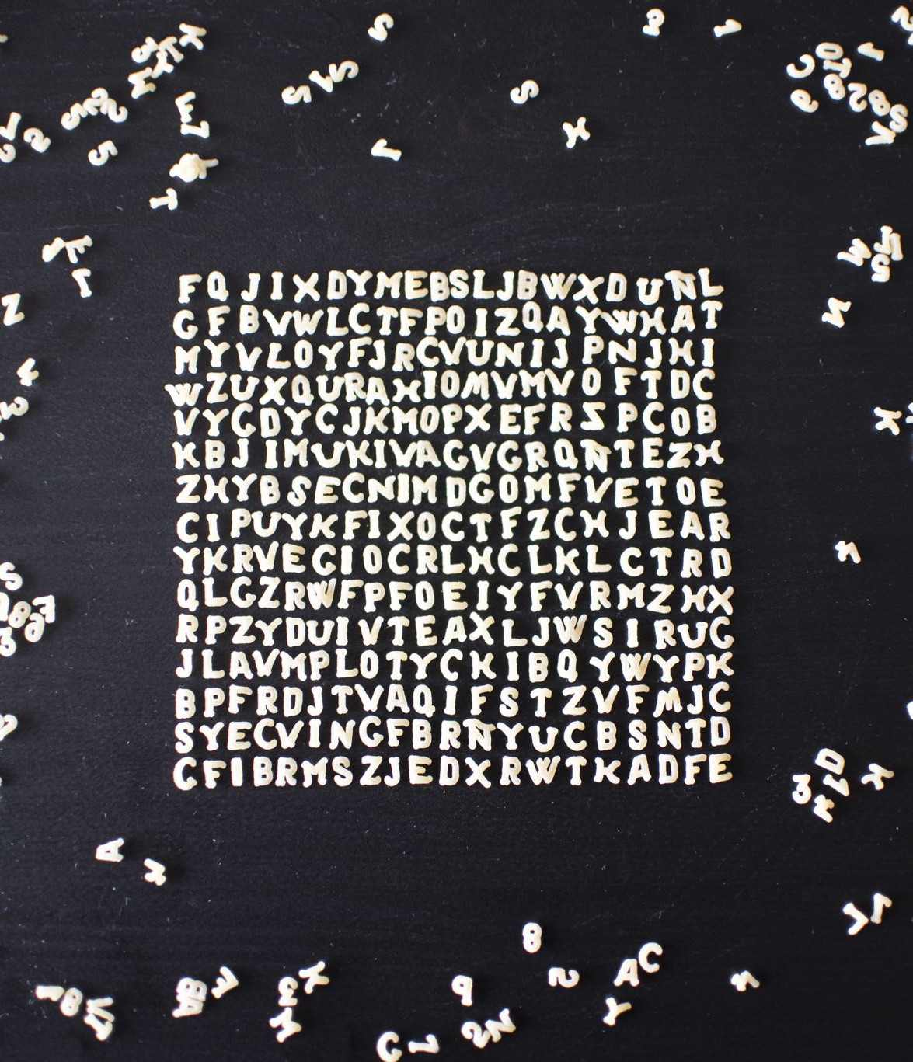
Primary Memory
Primary Memory is the main memory of the computer which is attached to the motherboard. It is fast in computer operation. Primary Memory holds only those data and instructions on which computer is currently working. It is more expensive than Secondary Memory. There are two types of Primary Memory they are:
Random Access Memory (RAM)
Read Only Memory (ROM)
Notes:
Primary Memory is the main memory of the computer which is attached to the motherboard

Slide 3

Random Access Memory (RAM)
RAM stands for Random Access Memory. When we boot the computer, it starts to load system file of operating system into the RAM. It holds only those data and instructions which the computer is currently working on. It is called volatile and temporary memory because it’s data is lost when computer is off. It is of two types they are:
Static RAM (SRAM)
Dynamic RAM (DRAM)

Slide 4
Static RAM (SRAM)
SRAM stands for static RAM. It is expensive than DRAM. It is used in cache memory. It is faster than DRAM. It’s structure is complex. SRAM don’t needs to refreshed the memory cell. Transistor are used to store information in SRAM.
Dynamic RAM (DRAM)
DRAM stands for dynamic RAM. It is cheaper than SRAM. It is slower than SRAM. It’s structure is simple. It needs more refreshed the memory cell. Capacitors are used to store information in DRAM.

Slide 5

Read Only Memory (ROM)
ROM stands for Read Only Memory. The data stored on the ROM are permanent and non-volatile. The data remains the same when computer is turned off. It is of three types they are:
PROM ( Programmable Read Only Memory)
EPROM (Erasable Programmable Read Only Memory)
EPROM (Electrically Erasable Programmable Read Only Memory)

Slide 6
PROM: It is memory chip stored on which we store a program. But once the PROM has been used, we cannot wipe it clean and use it to store something else.
EPROM: We can erase its stored program by exposing it to ultraviolet light. They are cheap, reliable and widely used.
EPROM: The program written on it can be erased using electrical signals.

Slide 7


